Slide 1
TECHNOLOGY ARCHITECTURE

Slide 2
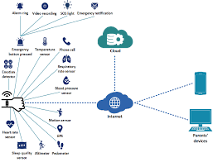

Slide 3
Emgency notification
Cloud
PIR Sensor
Alaram
Alaram ring
pParents phone
(notification,and Call)
GPS Sensor
Raspberry bi
WATCH
cInternet of things
Police
Pi camera
Power supply
Panic Button

